Slide 1
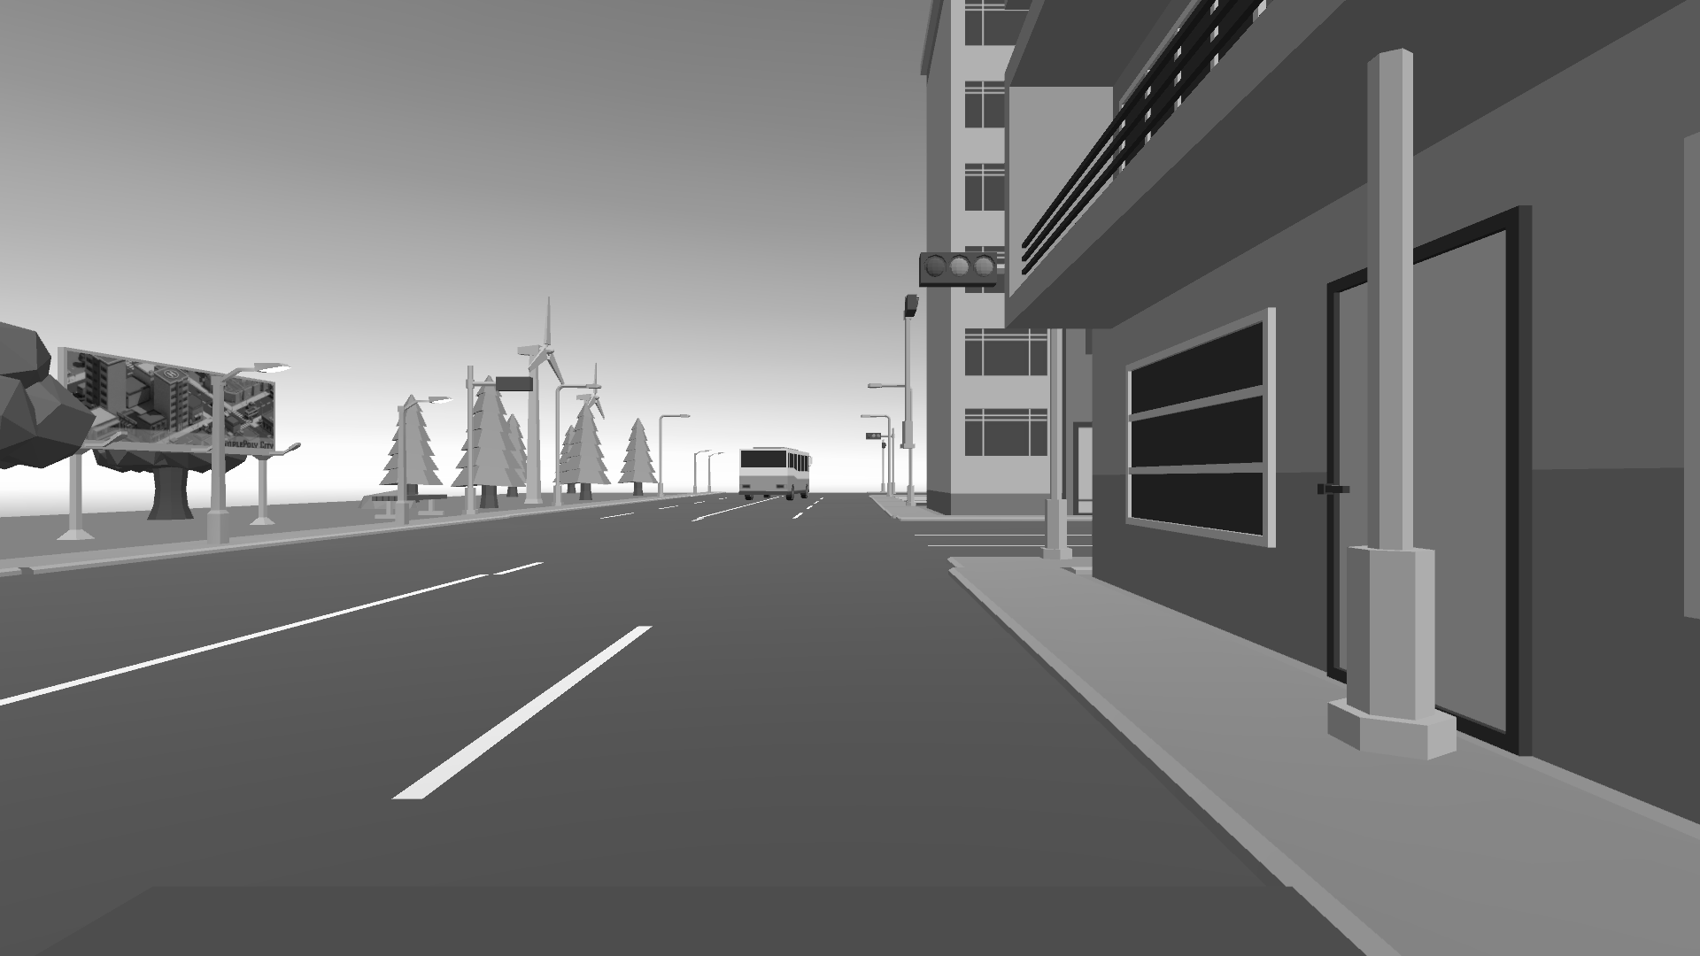
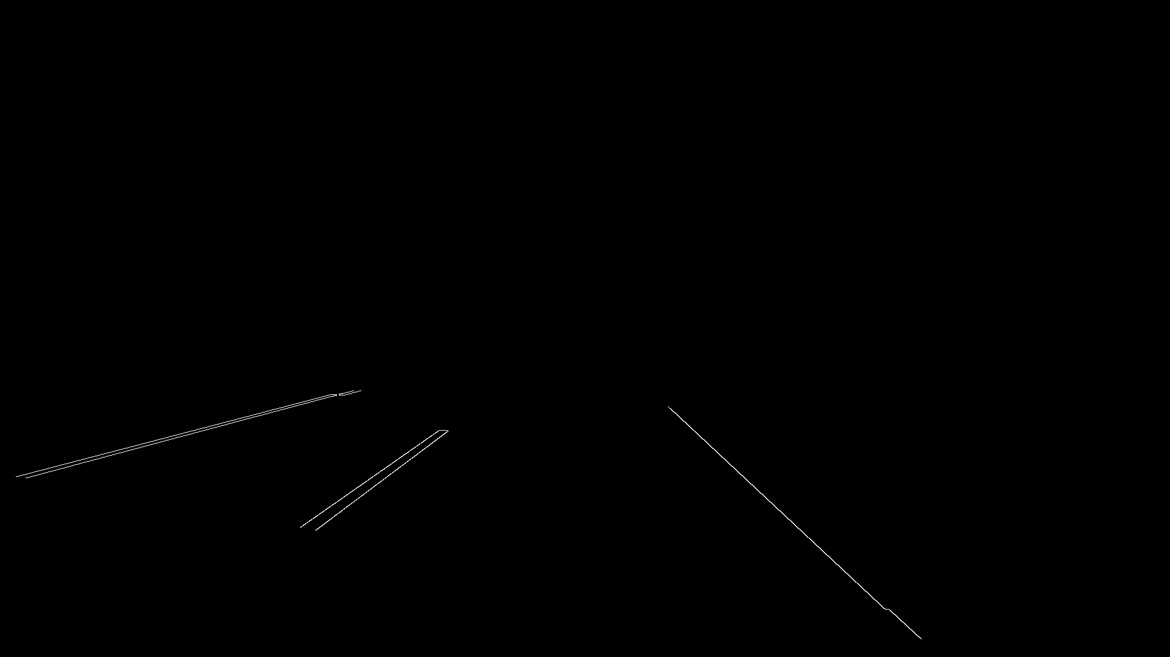
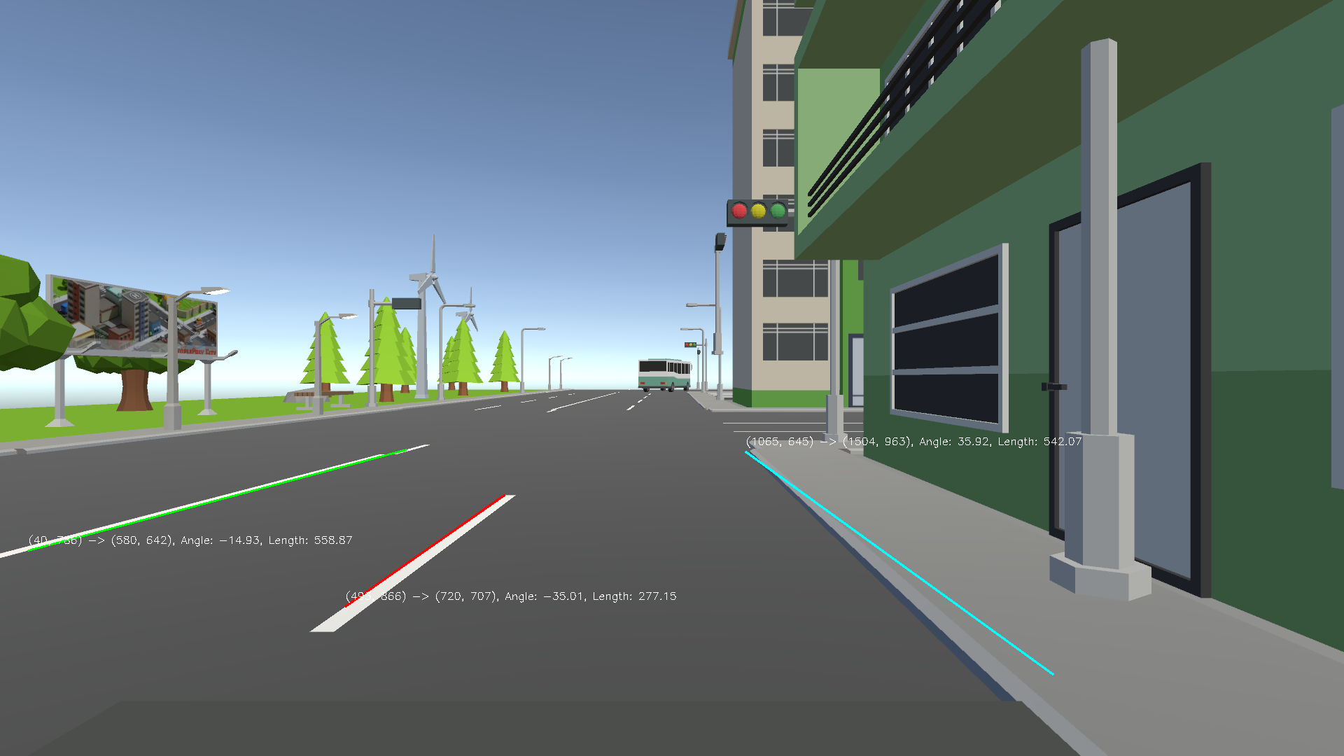
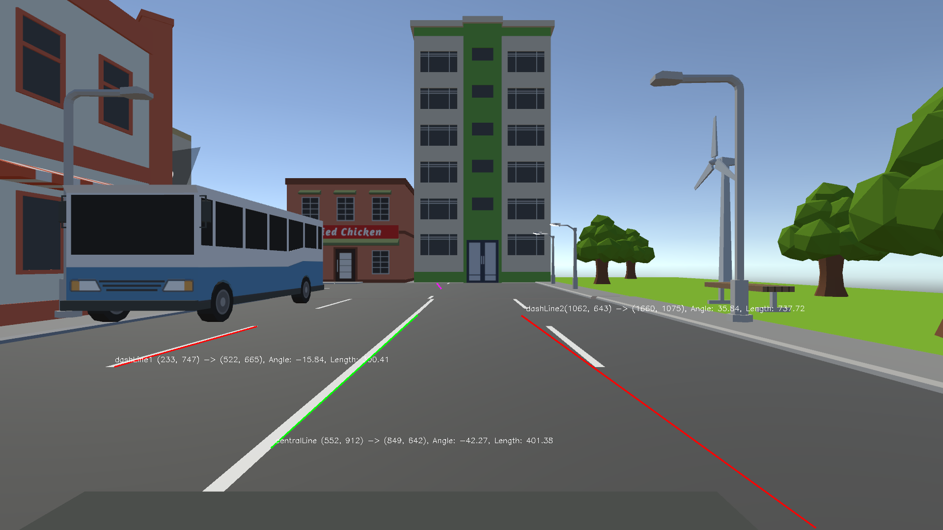
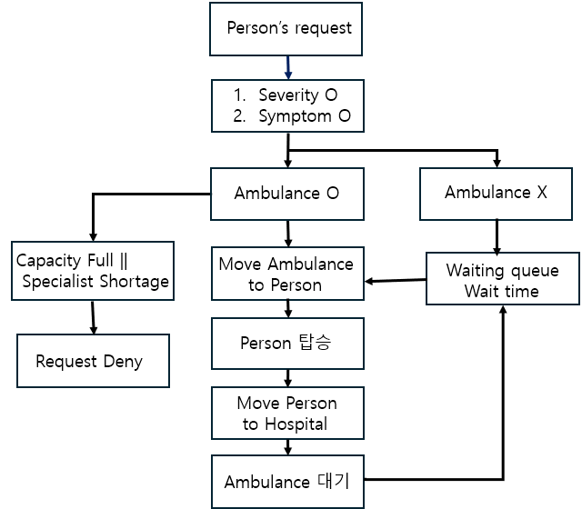
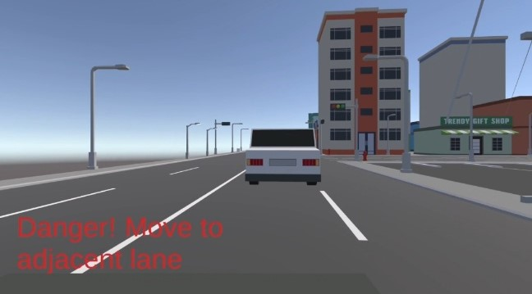
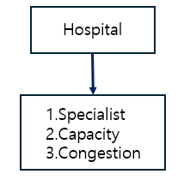
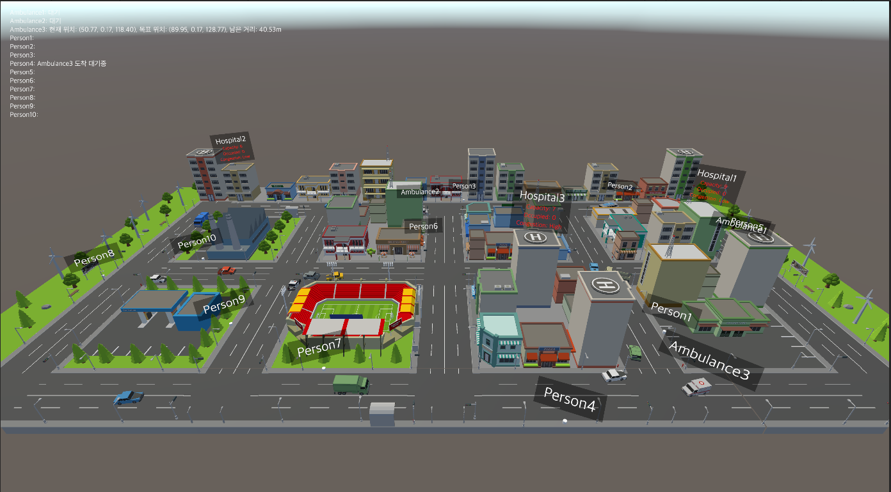

Hospital system with self-driving Ambulance
using Unity
Seo Yoon Jung Department of Biomedical Engineering, KyungHee University
[졸업 프로젝트 발표]
Introduction
2. Ambulance- Lane detection
Efficient emergency response is critical, especially when patients require specialized care in fields. Traditional ambulance systems often face delays due to limited availability of specialized hospitals connection, and the challenge of dispatching the nearest ambulance promptly. An autonomous ambulance system addresses these challenges by combining real-time patient prioritization with automated dispatch to optimize response times.
This system uses cameras and OpenCV-based lane detection to navigate multi-lane roads, staying within designated lanes and autonomously avoiding obstacles. Through Unity’s Raycast, it detects nearby vehicles, adjusting speed and switching lanes as necessary. By dynamically identifying the most suitable hospital based on proximity, congestion, and availability, this system ensures timely and efficient patient transport, reducing delays and saving lives in critical situations.
In this system, a camera is attached to a moving vehicle, capturing road images every second. Using OpenCV, each image focuses on a defined region of interest and processes it through greyscale conversion, Canny edge detection, and Hough transform to identify lane lines. The road is structured as a four-lane setup, with two lanes for each direction. Lines are classified into three types: central line, dashed line, and edge line (not walkable).
Lane 1: Positioned between the dashed line and edge line (not walkable). In camera view, the order appears as "central line, dashed line, edge line," indicating that the vehicle is in Lane 1.
Lane 2: Positioned between the central line and dashed line. In camera view, the order appears as "dashed line 1, central line, dashed line 2," indicating that the vehicle is in Lane 2.
Vehicles are restricted to Lane 1 and Lane 2, avoiding crossing the central line. Ambulances may cross the central line if no other vehicle is present.
Method & Result
1. Hospital system
The hospital system is composed of three main elements
: people, hospitals, and ambulances.
1. Patient Request Initiation
Patient requests are generated using a Poisson distribution, each request containing the patient's symptoms and severity level.
Symptom-neurosurgery, cardiology, internal, external surgery, thoracic surgery, pediatrics, psychiatry, obstetrics / Severity- 1~5
2. Hospital Selection Criteria
If there is only one hospital with adequate medical staff matching the patient’s symptoms and severity level, the patient is assigned to that hospital directly.
When multiple hospitals are eligible, a priority score is calculated for each:
Proximity Rank (1 for nearest, 2 for second-nearest, etc.)
+ Congestion Score (1 for low congestion, 2 for high).
The hospital with the lowest total score is chosen.
In the case of a tie in scores, one of the tied hospitals is randomly chosen.
3. Ambulance Assignment and Dispatch
The nearest available ambulance is assigned to respond to the patient.
If the closest ambulance is already in use, the next closest available one is chosen. The ambulance then travels to the patient's location, picks them up, and transports them to the designated hospital.
4. Waitlist Management
If there are not enough ambulances, the request is added to a waitlist.
Once an ambulance completes its current assignment and becomes available, it immediately begins processing the next request in the waitlist sequentially.
Figure 3. Grey image
Figure 4. Edge image
Figure 5. Hough image-lane1
Figure 6. Hough image-lane2
3. Ambulance- Avoid collision
Unity's Raycast is used to detect vehicles within a 20m range. If a vehicle is detected within 20m, collision avoidance actions are triggered.
Speed Control: Default speed is set to 5f. Speed decreases to 3f when slowing down and increases to a maximum of 7f when accelerating.
1. Vehicle Avoidance / Ambulance-to-Ambulance Avoidance:
If the adjacent lane (right or left) is clear, the vehicle shifts to it to avoid a collision. If the adjacent lane is occupied, the vehicle reduces speed.
2. Ambulance Avoiding a Regular Vehicle:
The ambulance attempts to shift to an adjacent lane if clear.
If the adjacent lane is blocked, the vehicle in front of the ambulance accelerates until the adjacent lane is clear.
The ambulance then increases its speed while remaining in the same lane.
If there are additional vehicles in front of the adjacent vehicle, the ambulance remains in its original lane and speed.
Conclusion
Figure 1. Hospital system diagram
〮 This system standardizes the hospital selection and transport process, eliminating the need for ambulances to rely on time-consuming calls to find available hospitals and inefficient transport
〮Adaptable to other emergency vehicles like police cars and fire trucks, this system enhances public safety and optimizes critical response efforts.
Reference
Autonomous Driving with Unity and BMW: 240 Million Virtual Kilometers -NICK DAVIS
Self-Driving Ambulance for Emergency Application -Mainak Kumar Das
Figure 2. Hospital system

